Slide 1

WINE CLUSTERING
A project by
Colleta Nandutu
Sylvia Ng'ang'a
Yves Havugimana

Slide 2
BUSINESS UNDERSTANDING

Slide 3
BACKGROUND
Wine is an alcoholic beverage made with the fermented juice of grapes.
Any fruit is capable of being used for wine
The difference between two popular drinks, wine and beer, is that wine is made from fruits, and beer is made from grains.

Slide 4
DEFINING THE QUESTION
We use unsupervised learning techniques such as Gaussian Mixture modeling to identify wine categories.
Dataset contains 13 numerical physical-chemical measurements used to identify distinct categories.
We use Silhouette Score to identify the number of clusters used in the model.

Slide 5
METRIC OF SUCCESS
The project will be considered a success when we are able to cluster wines based on numerical values which are their chemical compositions and properties.

Slide 6
EXPERIMENTAL DESIGN
Loading Libraries and dataset
Previewing Data
Cleaning Data
EDA - Univariate, Bivariate and Multivariate
Modeling (K-Means)
Challenging the solution

Slide 7
DATA UNDERSTANDING

Slide 8
DATA RELEVANCE
This dataset is adapted from the Wine Data Set from https://archive.ics.uci.edu/ml/datasets/wine
These data are the results of a chemical analysis of wines grown in the same region in Italy but derived from three different cultivars.
The analysis determined the quantities of 13 constituents found in each of the three types of wines.
The dataset has a total of 178 records and 13 columns.

Slide 9
DATA QUALITY VERIFICATION
Variables are named properly
There are no missing values
There are no duplicate records
There are less than 10 outliers from 6 variables

Slide 10
EDA

Slide 11
UNIVARIATE ANALYSIS
All variables are continuous
Most variables show non normal distributions

Slide 12
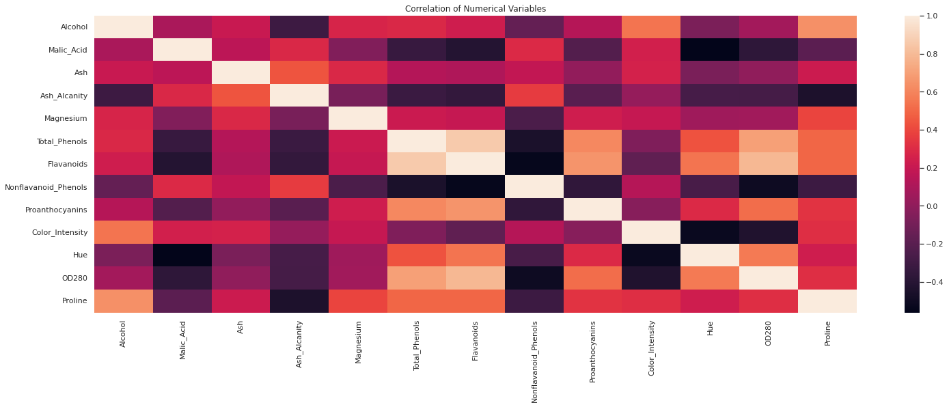
CORRELATION MATRIX
Variables are mostly not showing high correlations with other variables.

Slide 13
BIVARIATE ANALYSIS
“Total Phenols” show a high correlation with “Flavonoids”
“OD280” show a moderate correlation with “Flavonoids”
Other variables have insignificant correlations

Slide 14
MODELING

Slide 15
NORMALIZATION
Normalization prepares data for typical machine learning algorithms
We use MinMaxScaler to normalize our data

Slide 16
PRINCIPAL COMPONENT ANALYSIS
We perform PCA in order to determine several things:
The minimum number of dimensions necessary to preserve the majority of the information
This helps us determine whether a 3D visualization will be sufficient to see some of the inherent structure in our data.

Slide 17
PCA VARIANCE
We apply PCA with the number of dimensions equal to the number of features.
The resulting variance explained:
Percent variance explained by first 1 components: 39.3%
Percent variance explained by first 2 components: 60.1%
Percent variance explained by first 3 components: 69.0%
Percent variance explained by first 4 components: 75.9%
Percent variance explained by first 5 components: 81.3%
Percent variance explained by first 6 components: 85.9%
Percent variance explained by first 7 components: 89.4%
Percent variance explained by first 8 components: 92.0%
Percent variance explained by first 9 components: 94.5%
Percent variance explained by first 10 components: 96.5%
Percent variance explained by first 11 components: 98.0%
Percent variance explained by first 12 components: 99.2%
Percent variance explained by first 13 components: 100.0%

Slide 18
CLUSTERING
We fit our clustering algorithm using several different values of k where k is the number of clusters. We will have k range from 2 to 20.
For each value of k, we evaluate the clustering results using the average silhouette score. We will plot the silhouette score against each k value and identify which number of clusters leads to the best results.
We, then, assign cluster labels to our dataset using the fitted clustering model with the optimal number of clusters k.

Slide 19
SILHOUETTE SCORE
The silhouette score ranges from -1 to 1.
A score close to one indicates that a record is very close to other members of its cluster and far from members of other clusters.
A score of 0 indicates that a record lies on the decision boundary between two clusters.
A negative score indicates that a sample is closer to members of a cluster other than its own.

Slide 20
GAUSSIAN MIXTURE CLUSTERING
Gaussian mixture models allow for mixed membership
GMM models assign probabilities that a given record belongs to a given cluster. This property may be useful for classifying wines which are blends of multiple types.
GMMs are more flexible with regards to cluster shapes which deviate from a hyper-spherical one.
It is impossible for us to directly observe the actual cluster shapes visually since they exist in a 13-dimensional space, so it is helpful to have a clustering algorithm with such flexibility

Slide 21
GMM SUMMARY
After building and applying the Gaussian Mixture model to our data, we have the following:
The highest silhouette score is 0.317
The maximum number of clusters is 20
The first three silhouette scores are:
2 components: 0.294
3 components: 0.317
4 components: 0.267

Slide 22
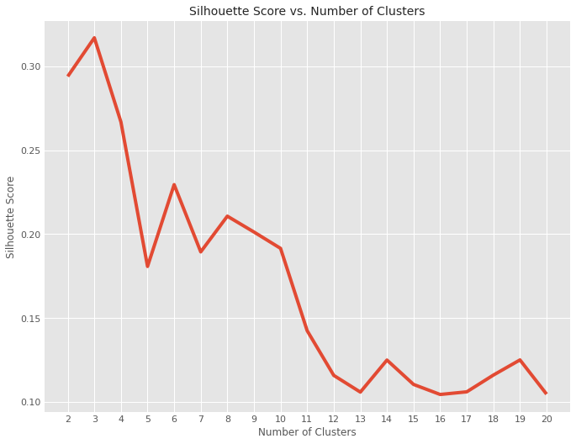
SILHOUETTE SCORE VS CLUSTERS
The silhouette score is maximized when 3 clusters are used.

Slide 23
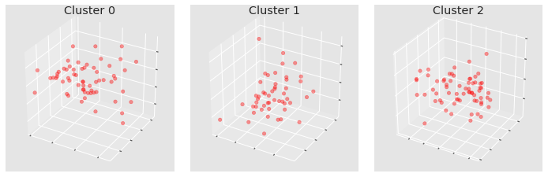
A VIEW OF THE THREE MAIN CLUSTERS
On the left, we have cluster 0, on the right we have cluster 2 and in the middle, we have cluster 1.

Slide 24
CLUSTERS DESCRIPTION
Cluster 0 has 61 records, Cluster 1 has 50 records and Cluster 2 has 67 records
The average Alcohol content is highest in cluster 0 and lowest in cluster 2.
The average Ash, Magnesium and Proline content follows the same trend as Alcohol
Malic Acid, Ash Alcanity, Nonflavanoid_Phenols and Color Intensity show higher averages in Cluster 1.

Slide 25
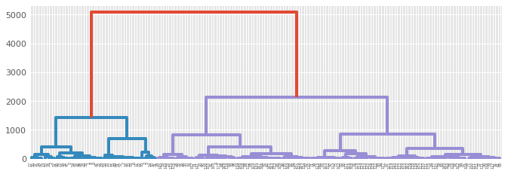
HIERARCHICAL CLUSTERING
Hierarchical Clustering shows there are three clusters

Slide 26
CONCLUSION

Slide 27
The project achieved its intended aim of clustering our wine. We have three clusters obtained using GMM:
Cluster 0 wines have a higher mean alcohol content and thus can be classified as dry wines.
Cluster 2 has the lowest alcohol content and thus will be sweeter that cluster 0 and 1 wines.
Given that cluster 1 wines have a higher Malic acid content,they will taste a bit more sour as compared to cluster 0 and 2 wines despite cluster 0 wines being drier than cluster 1.
The above conclusion is supported by the Hierarchical model that also provides us with three clusters.

Slide 28
THANK YOU !

